Slide 1
Physics game reserach.

Slide 2
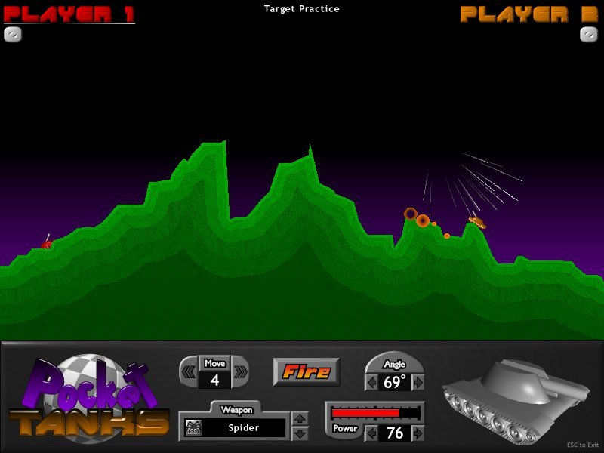
Pocket Tanks
Main pyshics mechanic: Trajectory, Gravity, Angles.
Play style: Turn based game play. Weapon customization.
The turn based game play allows players to be strategic when utilizing the angles and trajector y.
Weapons customization also allows for variety in game play. Making sure that no two plays can be the same.
Main gameplay take aways/main physhics implemented: Trajecrory, Gravity and angles work hand in hand to create a fun turnbased experience.
Destruction of enviroments could be strategically utilized by users as well as also creates a differnt play each time.
Fun
Hard fun: obstacles, strategy, goals (fustration, fiero).
Serious fun: repititon, rtythm
(zen focus, excitement).
People fun: compete
(amusement)

Slide 3
Cut the rope
Main physics mechanics implemented: Gravity, momentum, Trajectory.
Play style: One player, real time.
Players must time the trajectyory and momentum of the swing to be able to manipluate the directional movement of the piece of candy.
Although the game is played the real time, the implementation of the rope (sometimes swinging) gives the player time to be strategic with the physics mechanics.
What makes this fun: The fiero achieved from correctly manipulating the momentum and trajectory in order to feed the monster after many failed turns.
Possible adversary atributes:
Time trial between players to see who could feed the monster first.
Swap the candy with a rock whilst and have players engage in a turn based match in whilst visulising trajectory and momentum to cut the rope in order to injure(attack/kill) opposing players avatar.
Fun
Hard fun: obstacles, strategy, goals (fustration, fiero).
Serious fun: repititon, rtythm
(zen focus, excitement).

Slide 4
OLO
Main physics mechanics implemented: Trajectory, momentum, angles.
Play styles: Turn based, 2-4 players, ability to; steal, bounce back, and push out player coins. Players also have a life system. When a player uses a coin the the field the lose a life, when an oppenents coin lands in your safe space you can procced to steal that life.
The game is over when a player is out of lives. The player with the latgest score at the end of the game wins.
Turn based game play allows players ti be strategic. This is achieved through the use of trajectory and momentum to either slide indivudual coins or collide multiple coins to manipluate the game.
What makes the game fun: the friero of of scoring a point and stealing a players coin.
Fun
Hard fun: strategy, goals (fustration, fiero).
people fun: repititon, rtythm
(zen focus, excitement).

